Slide 1
On-chip sub-wavelength Bragg grating design based on novel low loss phase-change materials
Joaquin Faneca^{1,2}, Liam Trimby¹, Ioannis Zeimpekis², Matthew Delaney², Daniel W. Hewak², Frederic Y. Gardes², C. David Wright¹ and Anna Baldycheva¹
¹ Department of Engineering, University of Exeter, Exeter, EX4 4QF, UK
² Optoelectronics Research Centre, University of Southampton, Southampton, SO17 1BJ, UK
Abbreviated abstract: We propose a reconfigurable and non-volatile Bragg grating in the telecommunication C-band based on the combination of novel low-loss phase-change materials (specifically Ge₂Sb₂Se₄Te₁and Sb₂S₃) with a silicon nitride platform. The Bragg grating is formed by arrayed cells of phase-change material, whose crystallisation fraction modifies the Bragg wavelength and extinction ratio. These devices could be used in integrated photonic circuits for optical communications applications in smart filters and Bragg mirrors.
Related publications:
– J. Faneca et al, Applied Physics Letters 116 (9), 093502 (2020)
– J.Faneca et al, Optics Express,2020

Slide 2
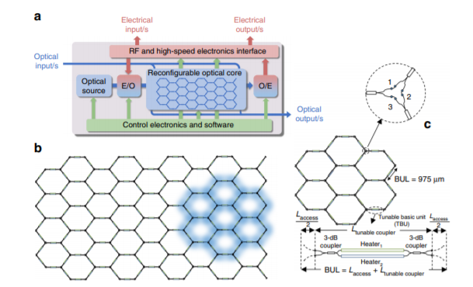
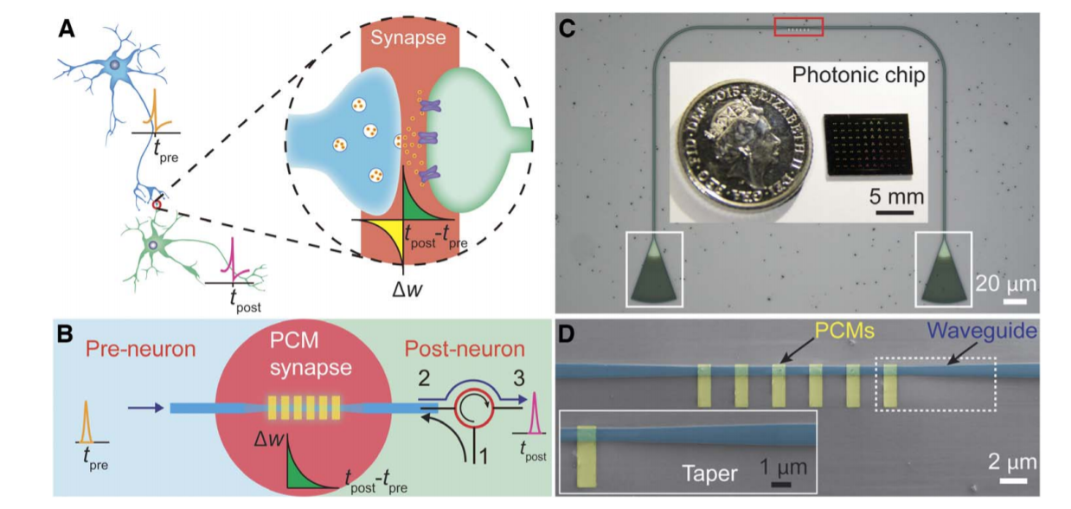
Previous work and challenge
To date, one of the challenges faced by silicon photonics is the large scale integration of non-volatile reconfigurable components such as switches, filters, directional couplers or memories to achieve programmable integrated circuits. Although some progress has been made in the last years creating different individual building blocks, the interest of non-volatile integrated circuits relies on using this components in different applications such as: opto-electronic oscillators (OEO), frequency combs, multifunctional reconfigurable photonic integrated circuits (PICs), arbitrary radiofrequency waveform generators (AWG), neuromorphic computing or quantum computing. In this work, we present individual building blocks in the C-band using novel low loss phase change materials (PCMs).
Fig 1. Multipurpose silicon photonics signal processor core using volatile switching. Daniel Perez et al, Nat coms, 2017
Fig 2. On-chip photonic synapse based on GST phase change materials. Zengguang Cheng et al, Science, 2017

Slide 3
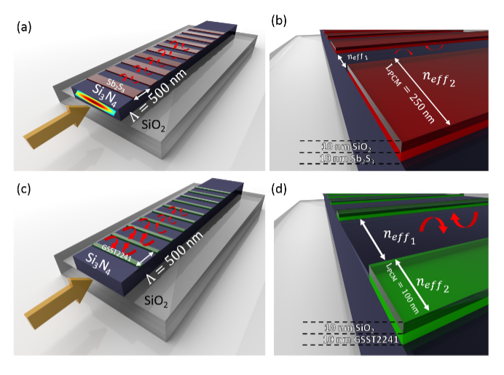
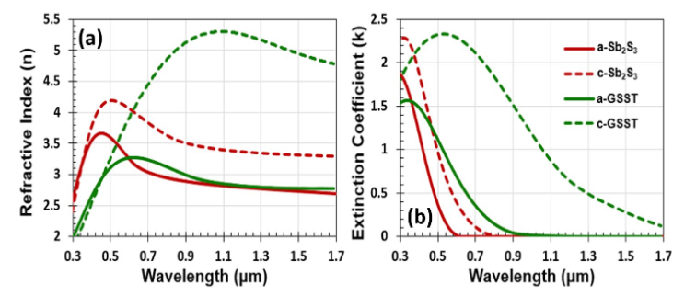
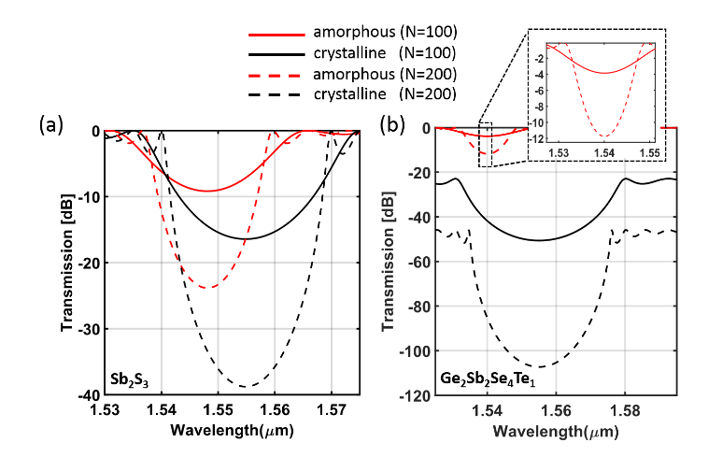
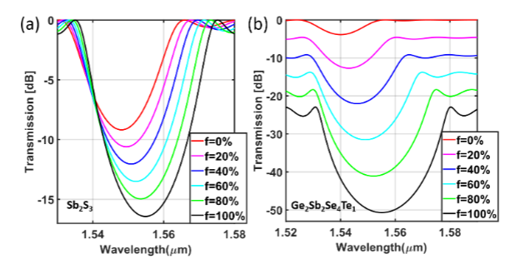
Design
Exploiting the effective refractive index change
Fig 3. a) Refractive index, n, and (b) extinction coefficient, k, ellipsometry measurements in amorphous (solid lines) and crystalline (dashed lines) state for Sb₂S₃ (red) and GSST (green).
Fig 4. Two different Bragg gratings have been proposed (a) using Sb₂S₃ with a fill factor FF=0.5 and (c) using GSST with a fill factor FF=0.2. (b-d) shows the internal reflections.
Controlling intermediate states in the phase change material cells
Crystallization fraction (f)
Fig 6. Two different Bragg gratings have been proposed (a) using Sb₂S₃ with a fill factor FF=0.5 and (b) using GSST with a fill factor FF=0.2 for 6 different levels of crystallization.
Fig 5. Optical response for different Bragg grating period number in amorphous state (red line) or crystalline state (black line), (a) for Sb₂S₃ and (b) for GSST.

Slide 4
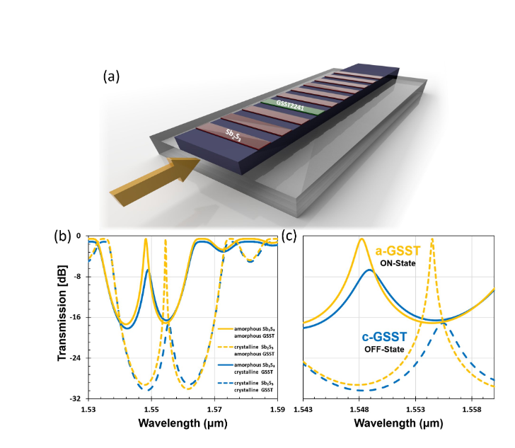
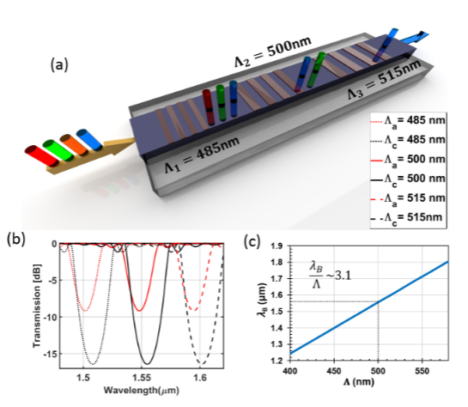
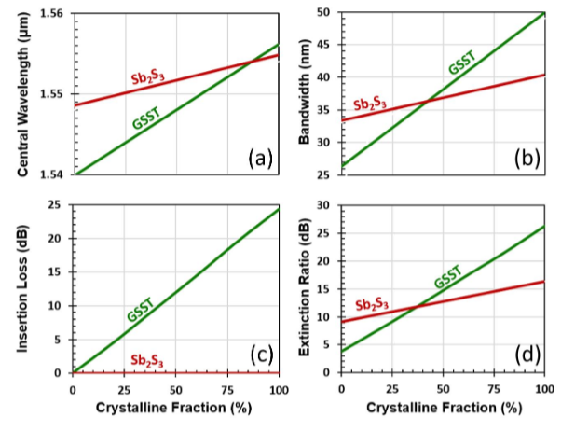
Results
A complete study of all the relevant parameters that comprises a Bragg grating (central wavelength, extinction ratio, bandwidth and insertion losses) has been made for both phase-change materials and different crystallization fractions.
Multilevel tuneable filters consisting of an array of 3 BGs placed in series has been demonstrated. Each grating has a different periodicity (Λ₁, Λ₂, Λ₃). Different wavelengths can be reflected and this device can be used to interact in each region of the Bragg grating with different molecules that reacts at different wavelengths.
Re-configurable, ultra-high quality factor filter based on phase-change materials. A defect in the Sb₂S₃ BG is created by replacing a Sb₂S₃ cell with a GSST cell. This generates an ultra-high quality factor peak in the Bragg resonance. Absorption within the defect (and therefore amplitude of high quality factor peak) can be controlled via the crystallisation fraction of the GSST.

